Slide 1
Hiring Process Analytics
Zaid Mohammad

Slide 2
Project Description
In this project, we analyze the hiring process of a multinational company by examining past hiring data. The goal is to identify key trends and insights, such as gender distribution, salary patterns, departmental composition, and position tier distribution. By cleaning and analyzing the data, we aim to help the company optimize its hiring strategies and make data-driven decisions.

Slide 3
Tech Stack
MS - Excel
PowerPoint

Slide 4
Data Cleaning
Here is a missing value so we can delete this one or we can also use average salary but, in this case, we chose to remove it because the application Status is rejected.
The Post Name column had one row with a hyphen (-), which was treated as missing. This row belonged to the Sales Department with an Offered Salary of 85,914. The missing value was replaced with the most common Post Name for Sales Department employees earning between 85,000 and 96,000, which is "c9".

Slide 5
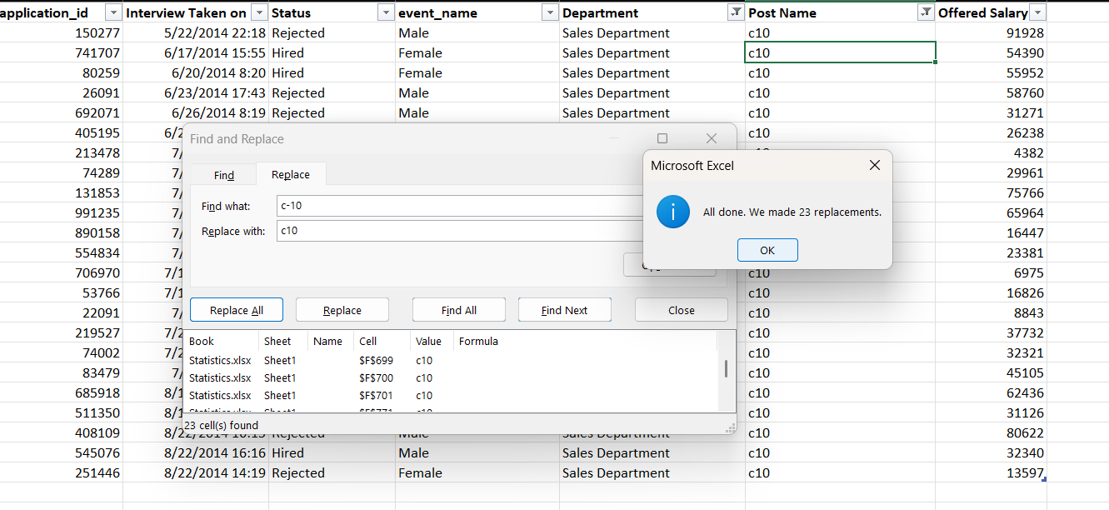
In the Post Name column, there was a typo where "c-10" was written instead of "c10", so it was corrected.
(In this SS I only had replaced the sales dept. c-10s but then I corrected it later by replacing it for all the depts.)

Slide 6
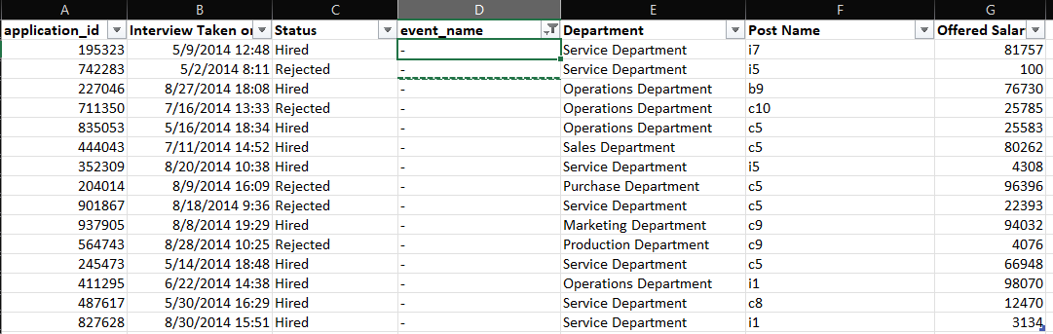
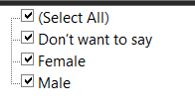
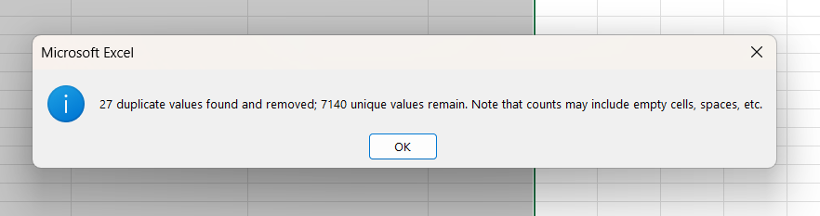
In the Event Name column, rows with a hyphen (-) were changed to "Don’t want to say ".
In the application_id column, rows with 27 duplicate IDs were removed.

Slide 7
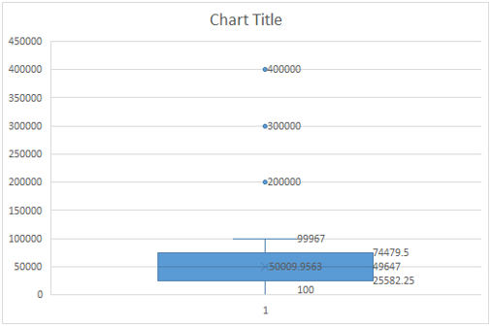
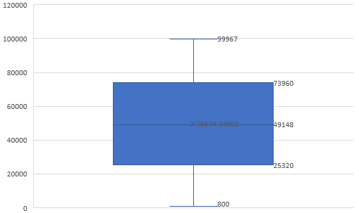
Outliers
The box and whisker plot for "Offered Salary" reveals outliers at 200,000, 300,000, and 400,000. The outliers were replaced with the Upper Bound.
Before
After

Slide 8
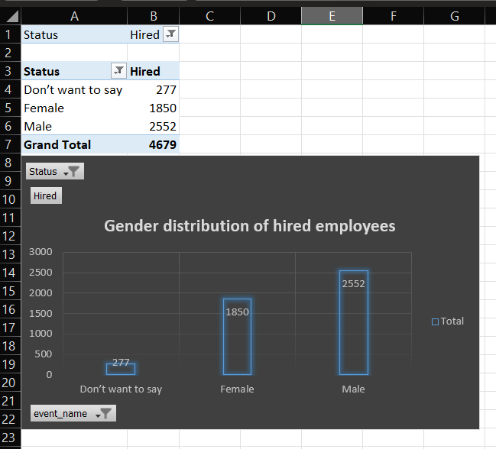
Data Analytics Tasks
A. Hiring Analysis

Slide 9
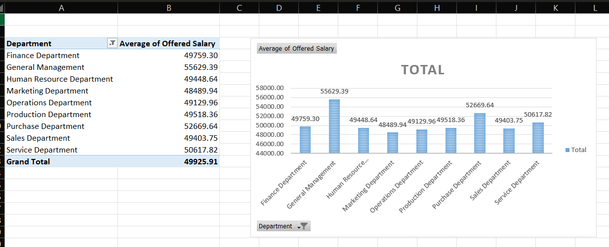
B. Salary Analysis

Slide 10
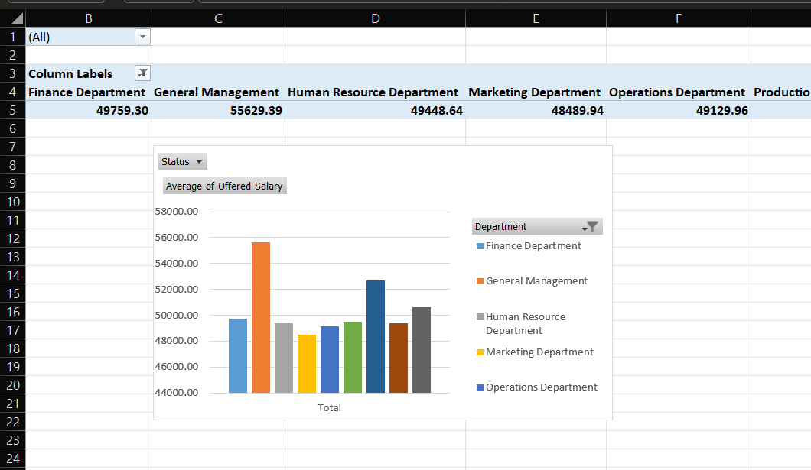
C. Salary Distribution

Slide 11
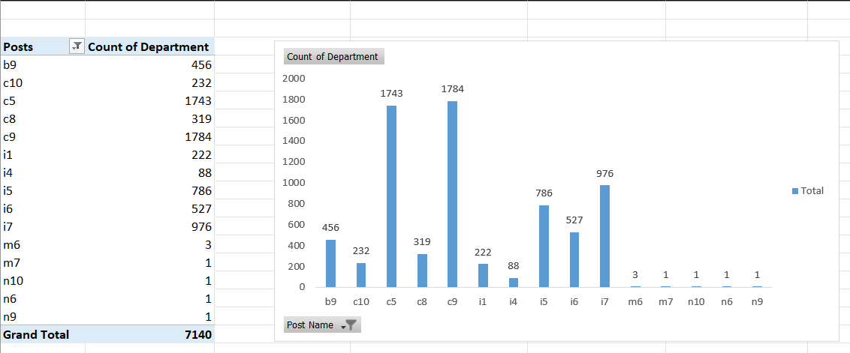
D. Departmental Analysis

Slide 12
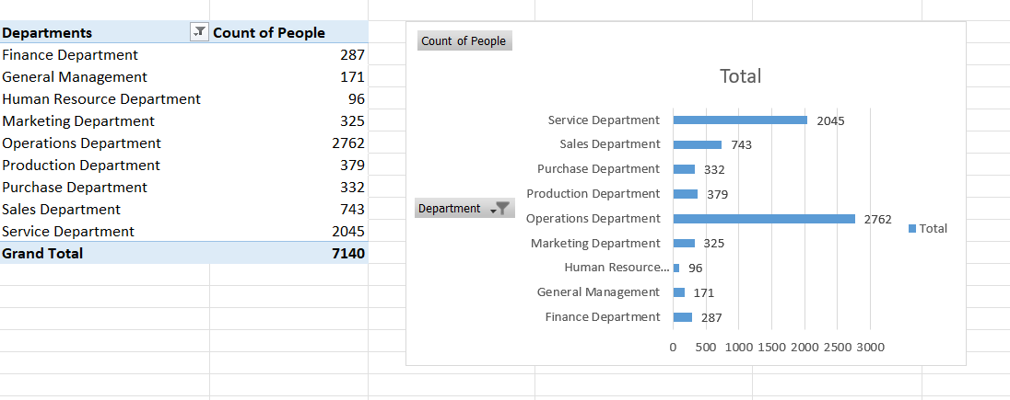
E. Position Tier Analysis

Slide 13
Insights
Through this project, I learned how data can reveal important hiring trends, such as diversity, salary patterns, and the needs of different departments. I got hands-on experience with cleaning messy data, creating clear charts, and analyzing the results. This helped me see how companies can use data to make smarter hiring decisions, promote diversity, and plan better for their recruitment needs. It also showed me how data can solve real-world problems and improve business strategies.
Excel Sheet Link - https://docs.google.com/spreadsheets/d/1iXM1o1Q2hlLIVWPBwu7tF_cgFfZ7vS-i/edit?usp=sharing&ouid=110673356967982932629&rtpof=true&sd=true

